Slide 1

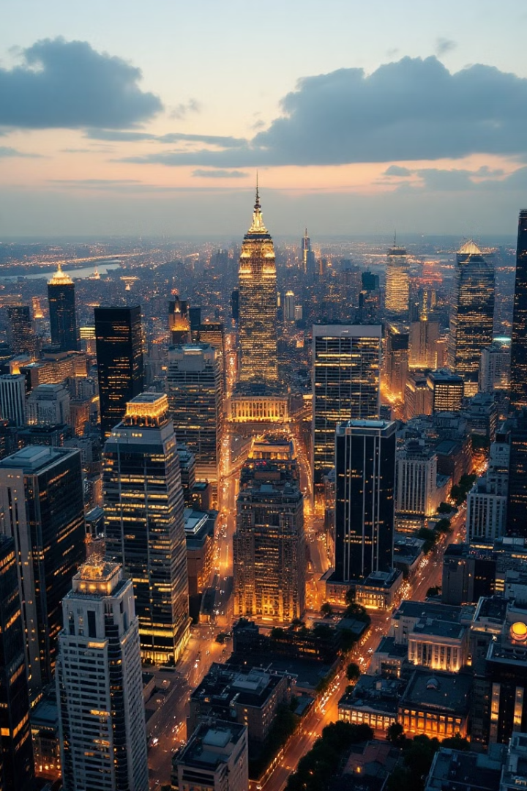
Unicorn Valuation Trends & Insights
Key Analysis & Strategic Recommendations
Presented by - Shivani Singh

Slide 2

What is a Unicorn?
$1B+ valuation
Aileen Lee
Innovation
Privately held startup
Coined term in 2013
Symbolizes investor confidence

Slide 3
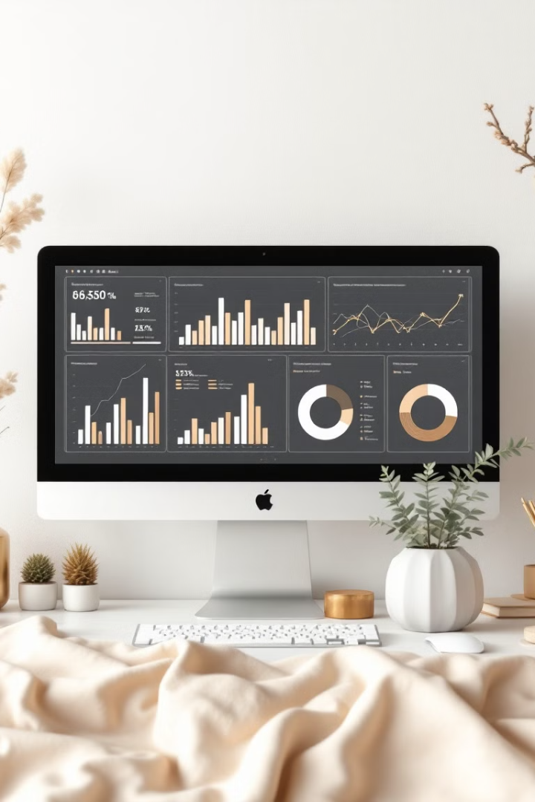


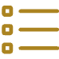
Dataset Overview
1,186
Data Source
Key Columns
Number of unicorns
Internal dataset provided by Unified Mentor for analysis.
Company, Valuation, Date Joined

Slide 4

Valuation Insights
Avg. Valuation
Median Valuation
$3.27B
$2B
Highest Valuation
ByteDance ($140B)

Slide 5
Geographic & Industry Distribution
Top Countries
Top Industries
USA
Fintech
China
AI
India
E-commerce
UK
SaaS

Slide 6
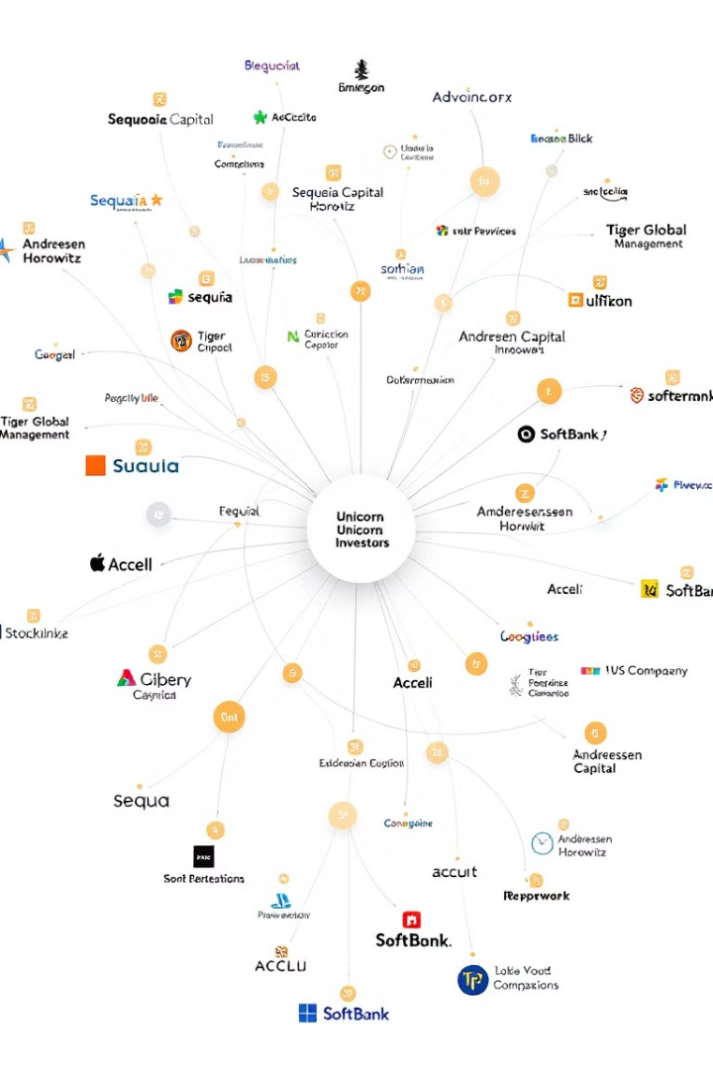



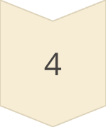
Investor Landscape
Sequoia Capital
SoftBank
Tiger Global
Andreessen Horowitz

Slide 7



Key Recommendations
1
AI
2
Web3
3
SpaceTech

Slide 8
Conclusion & Strategic Takeaways
Strategic Takeaways
Key Findings
US, China dominate
Focus on AI & Web3
Fintech, AI, e-commerce lead
Expand into India, SE Asia
Avg valuation: $3.27B
Diversify across industries
Top investors: Sequoia, SoftBank

Slide 9


Next Steps
High-Growth
Target unicorns with potential
Emerging Sectors
Assess future investments
Top Investors
Build co-investment partnerships

